Slide 1
Travel ai agent
EDUNET IBM INTERNSHIP PROJECT
Presented By:
Student name :Mohd Farrakh Nizam
College Name & Department : Chandigarh engineering college,jhanjeri,Mohali
Aicte id: STU680f1ff9dd6b21745821689
Edunet id:farrakhnizam90@gmail.com

Slide 2
OUTLINE
Problem Statement
Technology used
Wow factor
End users
Result
Conclusion
Git-hub Link
Future scope
IBM Certifications

Slide 3


Problem Statement
The Challenge:
Manual trip planning is complex, time-consuming, and often stressful. Users struggle with:
Endless research across multiple platforms.
Personalizing plans for preferences, budgets, and constraints.
Adapting to real-time changes.
Proposed Solution:
The AI Travel Planner Agent
AI-powered assistant using NLP & RAG.
Suggests destinations, builds dynamic itineraries.
Recommends transport/accommodation.
Integrates maps, weather, local guides for seamless experience.
Manages bookings, alerts, and optimizes schedules on the go.

Slide 4


Technology used
IBM CLOUD SERVICES USED
IBM Cloud Watsonx AI Studio: Development, orchestration, and deployment of AI models.
IBM Cloud Watsonx AI runtime: Scalable infrastructure for agent execution.
IBM Cloud Agent Lab: (If directly used for specific agentic frameworks).
IBM Granite foundation model: Powers NLP, understanding, and generation for smart responses.

Slide 5
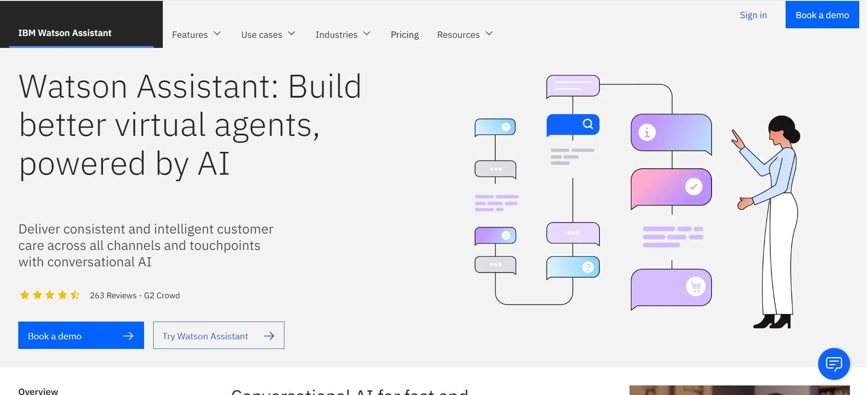
IBM cloud services used
IBM Cloud Watsonx AI Studio
IBM Cloud Watsonx AI runtime
IBM Cloud Agent Lab
IBM Granite foundation model

Slide 6

Wow factors
Significantly reduces travel planning time & improves personalization.
Unique Features:
Real-time Destination & Itinerary Generation.
Personalized Recommendations (transport, accommodation, activities).
Dynamic Adaptation & Optimization (alerts, schedule adjustments).
Seamless Integration (maps, weather, local guides).
(Optional: Direct Booking Integration - mention if partially implemented or key future feature)

Slide 7
End users
Academic Researchers
Research Institutions and Universities
Industry R&D Teams
Educators

Slide 8
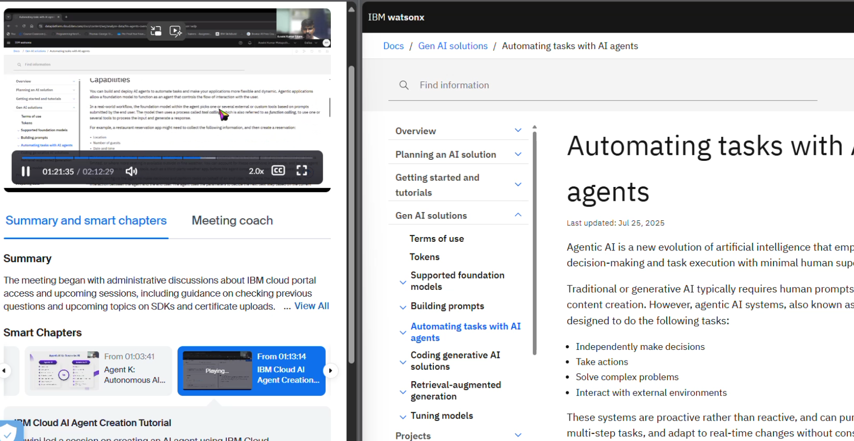
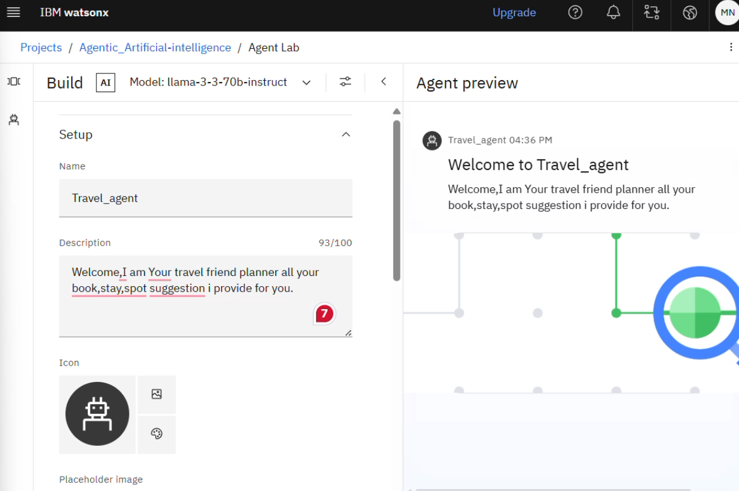
Results

Slide 9
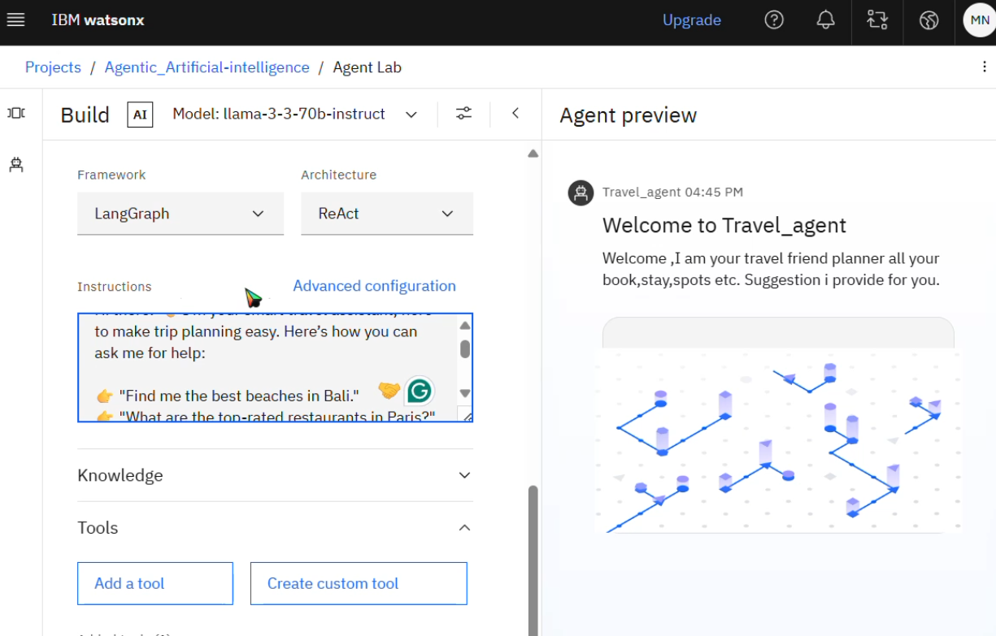
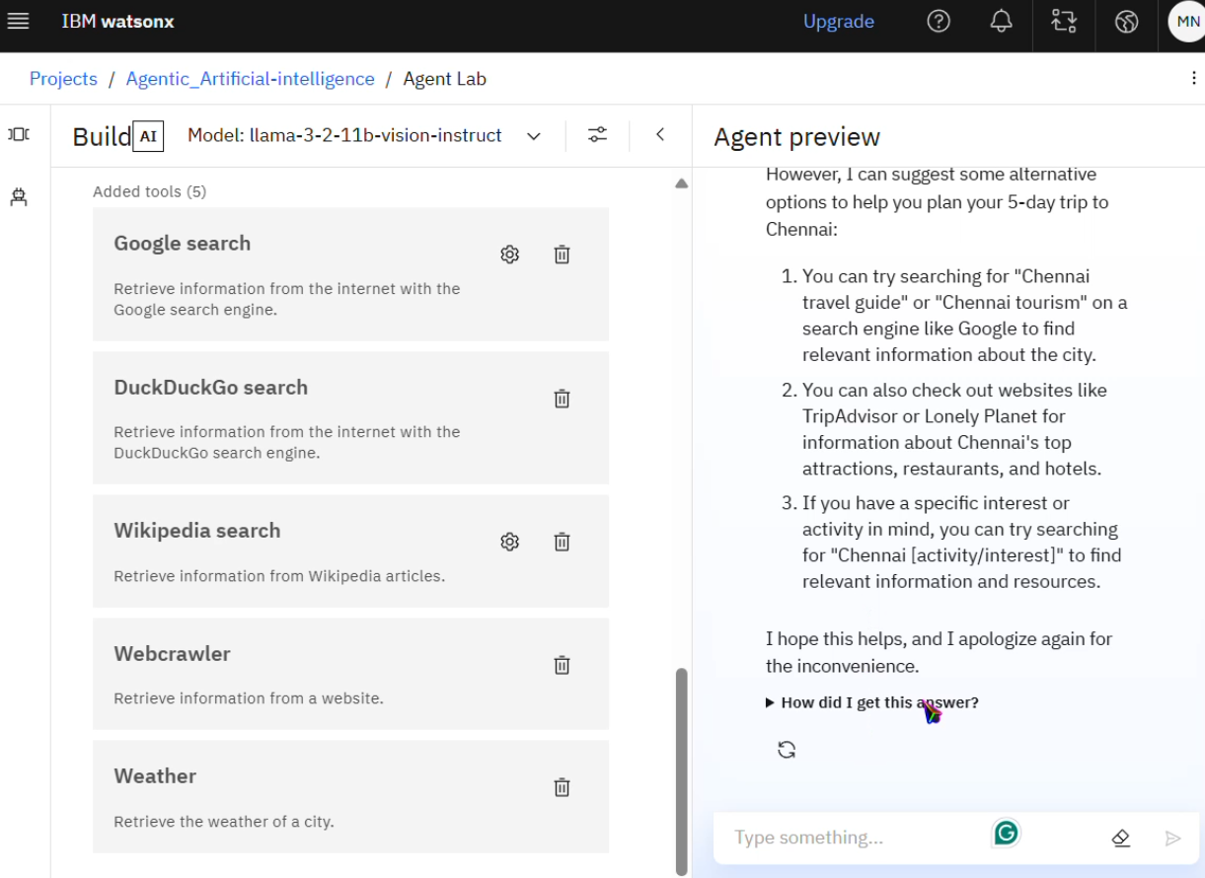
Results

Slide 10
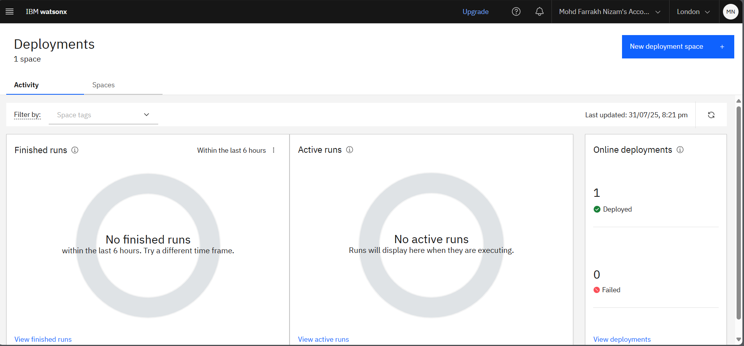
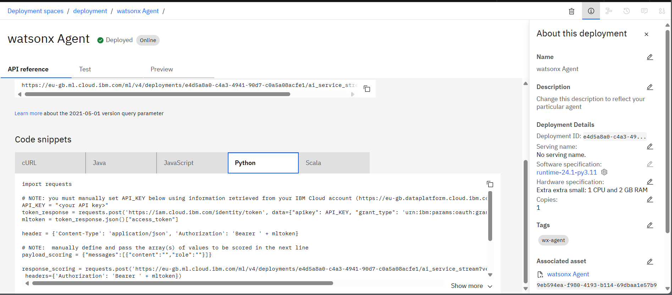
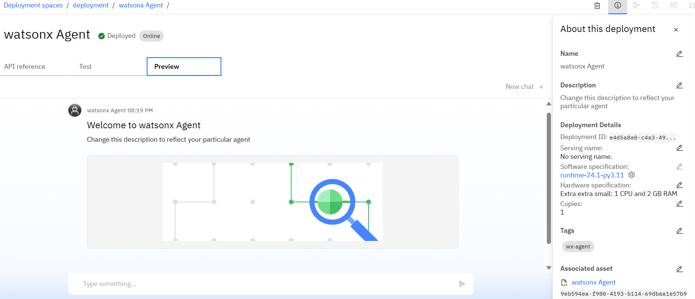
Results:
Deployed AI Agent
1 2 3

Slide 11
Conclusion
The agent can generate reports, suggest hypotheses, and even draft sections of research papers.
It saves time by automating repetitive tasks like citation management and data extraction.
Research Agents enhance efficiency, accuracy, and innovation in both academic and industrial R&D.

Slide 12
Future scope
Advanced Personalization & User Feedback Loops.
Direct Booking Integration & On-trip Support.
Voice Interface & Multi-modal Input.
Research Gap and Novel Topic Identification
Integration with Publishing Platforms
AI-Assisted Paper Drafting

Slide 13
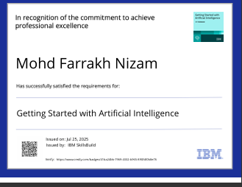
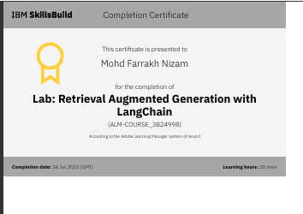
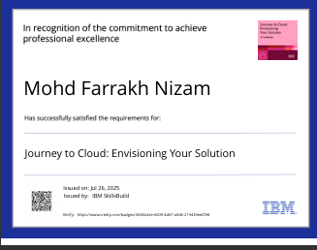
IBM Certifications

Slide 14
GitHub Link
https://github.com/farrakhnizam786/Agentic_AI-Travel_Agent-using_watsonx

Slide 15
THANK YOU

